Slide 1


Introduction to Employment Services and Programs

Slide 2

Life After School
The transition from school life to adulthood is no different for a teenager with developmental disabilities
Choices for the student moving from school to adult life can include continuing education, getting a job or taking part in other meaningful activities, such as volunteering and job or life skills development

Slide 3


Tips for parents and students
• Start early; it’s never too early to investigate the possibilities.
The conversation about employment should start while still in school. Talk with your School Support Team (Transition Coordinators, Parent coordinator, Teachers)
• Ask questions; find out what options exist in your community and how to apply for them.
• Learn about the eligibility process for getting services. Find out what documents you need to provide so that supports are ready when needed.

Slide 4

What is SUPPORTED EMPLOYMENT?
General term used for employment services that provides support to people with Disabilities to help with their goal to obtain and maintain competitive employment.
Supported Employment Services can be provided to from various city and/or state funded entities.
-More commonly you will hear about OPWDD Supported Employment or ACCES-VR Supported employment. These are two major funding sources in NYS for supported Employment.
Employment services are designed to be person centered.
Service tracks vary based upon a person’s experience, level, support needs and employment history.
Support Staff complete various assessments to help determine which employment journey is best for you.
People can receive a holistic schedule of other supports and services.

Slide 5
What do you mean by funding sources and eligibility?
Adult Career & Continuing Ed Services (ACCES VR)
Provides vocational rehabilitation services to individuals who have a disability, or disabilities, that Impact their ability to secure, retain, advance in, or regain employment.
Assistance with college programs, job training programs, and supported employment programs Pre -employment training, e.g. career exploration or work readiness coaching
Typically, Faster paced, specific to time limited authorizations, less supports provided.
Candidates must be : 1. Be at least 14 years old; AND living in NYS and able to work in the United States 2. Have a disability that interferes with an ability to obtain, maintain, or advance in a job. (ex: physical, intellectual or learning disability) 3. Available and willing to actively participate in the vocational rehabilitation process.
Office for People with Developmental Disabilities (OPWDD)
Programs provided by OPWDD can offer an introduction to career planning or an internship that could lead to a job in a community business, with on-the-job supports once you find a job. May be used separately or together to help you reach your goals and take part in your community.
Usually combined with a series of Discovery Based services such as : Pathway to Employment (PTE).-Community Based Prevocational (CBPV) Services Employment Training Program (ETP)- followed by more long Term Supported Employment ( SEMP)
Usually, intended for those with long term job goals and need more support to learn work readiness. Variety of time frames and goals authorized services.
Typically, you will transition to OPWDD Supported Employment AFTER you have received authorization funded by the NYS Adult Career and Continuing Education Services-Vocational Rehabilitation (ACCES-VR).
Candidates must be : 1. Be at least 18years old , out of school, living in NYS and able to work in the United States 2. An individual with a diagnosed developmental disability 3. Be eligible for OPWDD Services & enrolled in the Home and Community Based Waiver

Slide 6
AcceS-VR 1st Steps:
Eligibility Determination and options
If eligibility & service authorization approved: meet with ACCES-VR Counselor to create IPE, or request support from an approved service provider who will complete and intake and IPE.
Assessments and Planning
Staff provides job readiness activities, discovery and/or training based on IPE provided by ACCES-VR
Contact
ACCES-VR to apply for services
Apply to ACCES-VR and schedule to meet with ACCES Counselor for interview.
ACCES Counselor will review application to determine eligibility.
If eligibility & service authorization denied: explore other options for supported employment services such as DOH or DYCD.
Staff complete intake meeting to discuss service types then determine plan for long term supported employment and funding source
Placement or follow up
Ideally, after a person completes these steps, they will be successful in obtaining a job.
If Job placement is successful, staff provide long term supports based on authorizations, eligibility and level of support needed
If job placement is undetermined at this step, staff provide additional service options that would support someone in their long-term goal for employment ex: Day Hab, another discovery-based services or refer back to ACESS-VR.

Slide 7
OPWDD Services- 1st Steps:
Initiate Front Door Contact
Call 866-946-9733 for a Front Door Facilitator.
Front Door Facilitator will assist in contacting a Care Manager Provider.
Proof of Eligibility
Documents are submitted to OPWDD to review for Eligibility to receive services.
Care Managers will help find and schedule appointments for these reports, as well as submit any required documents.
Request of Services to OPWDD
Once approved for OPWDD services, your Care Manager will submit a request of services that you would like to receive. This includes, Day habilitation, Respite, Employment ETC.
OPWDD will inform the approved services through a Notice of Decision.
Assessments and Planning
Placement or follow up
Care manager will assist person supported to identify appropriate programs and make referral for OPWDD funded employment services (ETP, Community Based Pre-vocational, or Pathway to Employment) to an approved service provider.
Staff complete intake meeting to discuss service types then determine plan for long term supported employment and funding source
Staff provides job readiness activities, discovery and/or training based approved OPWDD services
Ideally, after a person completes these steps, they will be successful in obtaining a job.
If Job placement is successful, staff provide long term supports based on authorizations, eligibility and level of support needed ( SEMP- Intensive or Extended)
If job placement is undetermined at this step, staff provide additional service options that would support someone in their long-term goal for employment ex: Day Hab, another discovery-based services.
Psychological, Psychosocial, Medical and any document that supports the disability started before 22.
Select a Care Coordination Organization- provider. ( ACA, Tri-County, Care Design)
If eligibility & service authorization denied: explore other options for supported employment services such as ACCES- VR, DOH or DYCD.

Slide 8
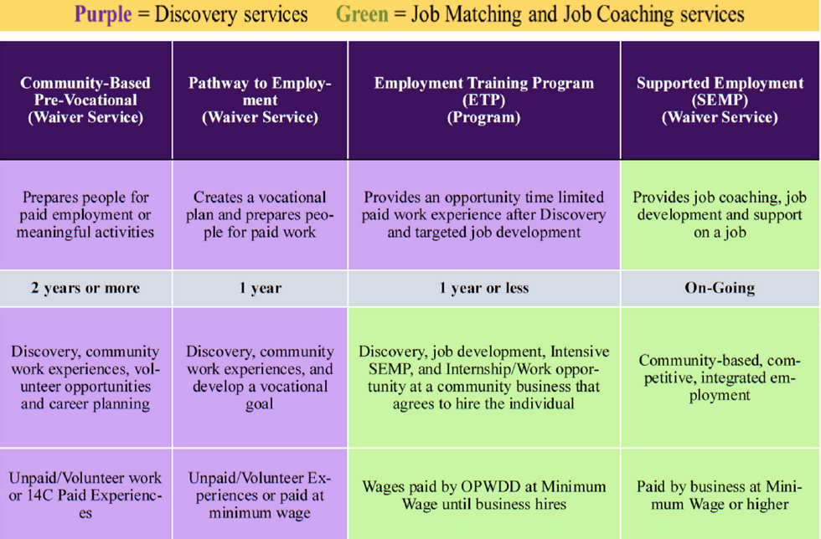
What are Discovery Services ?
To prepare for work service organizations provide a variety of work readiness programs through community activity, assessments & interviews that are referred to as “Discovery Services”.
AFTER completing discovery and if you are ready for work, there is support for job matching and development that will hopefully lead to ongoing employment and job coaching services as needed.

Slide 9
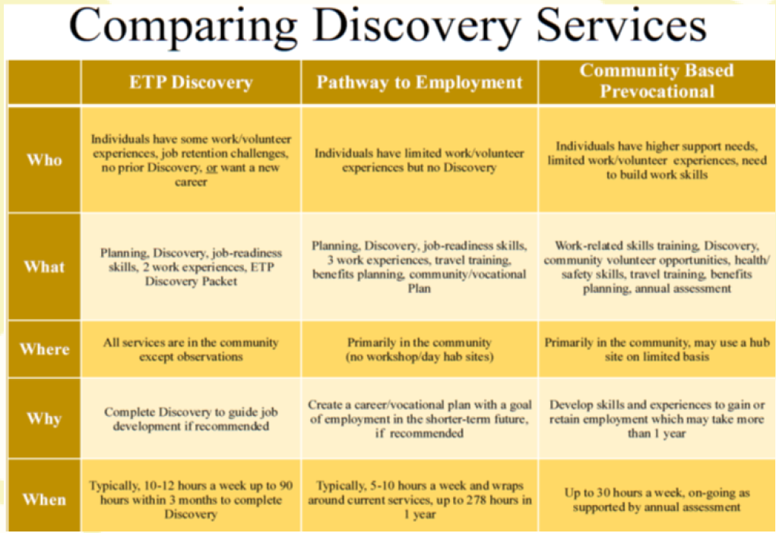
What are Discovery Services ?
You may notice that they are similarities such as the time frame or Activity.
On this grid, you can compare the different discovery services based on work experience, skills and how services are provided
To be eligible for these services, a person needs to be eligible for OPWDD Services & enrolled in the Home and Community Based Waiver.

Slide 10
Community Based Prevocational Service- Discovery

Slide 11

COMMUNITY BASED PREVOCATIONAL SERVICES;
CBPV
Limited amount of time can be provided at a program or non-integrated sites
Should take place primarily in the community
Focused on vocational skills and community work experiences.
Flexible schedule/day based on specific work related activity, rarely a full day

Slide 12
Pathway to Employment - Discovery

Slide 13

PTE
Pathway to Employment is a time-limited, person-centered, comprehensive, career and vocational planning and support service.
The goal of this service is to help people develop a vocational plan with an identified career path to obtain competitive integrated employment in the future.
Uses an individualized career and vocational planning process to identify the person’s vocational strengths and interests. This service includes community vocational experiences and support services.
1-4 internship sites ranging from 10-25 hours each to conduct assessments and job readiness skills training.
The outcome of Pathway to Employment is a career, vocational and transition plan document which includes the next steps for achieving self-employment or competitive, integrated employment at or above the applicable state or federal minimum wage.

Slide 14
Employment Training Program (ETP)-Discovery

Slide 15

ETP-Discovery
To obtain various perspectives on the individual’s background, progress, skills, abilities, preferences, experiences, and support needed.
Serious of job specific situational assessments and progressreports.
Collect information about an individual’s practical work performance by simulating a work environment at a location in the community that exposes them to realistic expectations in career areas they may enjoy.
Obtain information about the individual’s interests, motivators, interpersonal/soft skills, independence, behavior, physical ability, self-care skills, safety awareness, and support needs through direct observation
Person supported is paid through funding from OPWDD. If placement is successful, the person is hired by the employer and added to their payroll.

Slide 16
SUPPORTED EMPLOYMENT- (SEMP)

Slide 17

INTENSIVE -semp Extended -SEmp
Job Developer and Job Coach assigned to the participant.
Job Developer will assist in obtaining employment.
Job Coach will assist in interview preparation and employment search.
Once employment is obtained, the Job Coach will provide travel training and coach the participant in their assigned work task, with the main goal of achieving independence.
Job Coach will complete minimum 2 in-person visits at work site per month.
Speak with participant and manager for their opinions regarding the participants performance.
If intensive coaching is needed, the Job Coach will coach the participant in any task needed or coach them in a new assigned task.

Slide 18

Are there any other options that may work better for me?
Absolutely! NYC and NYS have a variety or different programs and services available.
Other programs often are meant to be for a period of a few weeks- few months, related to specific job or field and may have age or other requirements
Some other kinds of employment programs include:
1. DYCD-Youth Job Specific Training- offered through NYC to youth ages 16-24 that meet other various criteria. Classroom learning, on site internship and one year follow up support for job placement. Developmental Disability not required
2. CSVT- OPWDD eligible Job Specific training – offered in cohorts and provided through support from a multi- agency provider team ( usually inter-borough). Classroom learning, onsite internship, support for job placement. Ages 18 and up. Must be enrolled in HCBS Waiver services.
3. DOH/ DOHMH- offered though Department of Health- supports people with physical disabilities and/or mental health diagnosis.
4. OPWDD Self Direction- People who are eligible for OPWDD services and enroll in Self-Directed services, can use their allotted budget towards community classes, training and other educational resources that may help someone with their employment goals.

Slide 19

Questions ?

