Slide 1
Disability
Initial & Continuing Eligibility
01/14/2026

Slide 2
Social Security: Definition of Disability
To meet SSA’s definition of disability, you must not be able to engage in any substantial gainful activity (SGA) because of a medically determinable physical or mental disability(ies) that is either:
  Expected to result in death.
  Has lasted or is expected to last for a continuous period of at least 12 months.

Slide 3
Supplemental Security Income (SSI)
Federal monthly cash benefit
  Administered by Social Security Administration
  Aged (65+), blind or disabled
  Maximum payment amount (based on living arrangement):
    Independent living: $1081 (alone), $1017 (with others), $685.67 (in household of another)
    (VO) Individualized Residential Alternative (IRA): $1,429/$1,399
    Resource limit: $2,000

Slide 4
Supplemental Security Income (SSI)
Other factors affecting SSI initial eligibility
  Substantial gainful activity (SGA)
      Monthly gross income limits
      Non-blind: $1,690
      Blind: $2,830

Slide 5
Applying for SSI
Make appointment with SSA
  By phone or online
  SSA will send application form
Protect the filing date
  Benefits payable beginning the first of the month following filing date
Representative payee (RP)
  Under 18 or not capable of managing benefits
  Request to be appointed should be included with application
DO NOT wait for SSI to be approved – apply for Medicaid separately!

Slide 6
Social Security Benefits
Federal insurance program
  Retirement
  Survivors
  Disability (SSDI)
    Disabled Adult Child (DAC) benefit
Not needs-based
Based on work credits earned
  By person themselves
  By parent(s)
  By spouse

Slide 7
Social Security Benefits
Factors affecting continuing Social Security eligibility
  Substantial gainful activity (SGA)
      Non-blind: $1,690
      Blind: $2,830

Slide 8
Medicaid
Health insurance program
  Pays for medical and OPWDD services
  Income and resource limits
    Not all income “counts”
    Spenddowns
    MBI-WPD
  Coverage automatic for SSI recipients

Slide 9
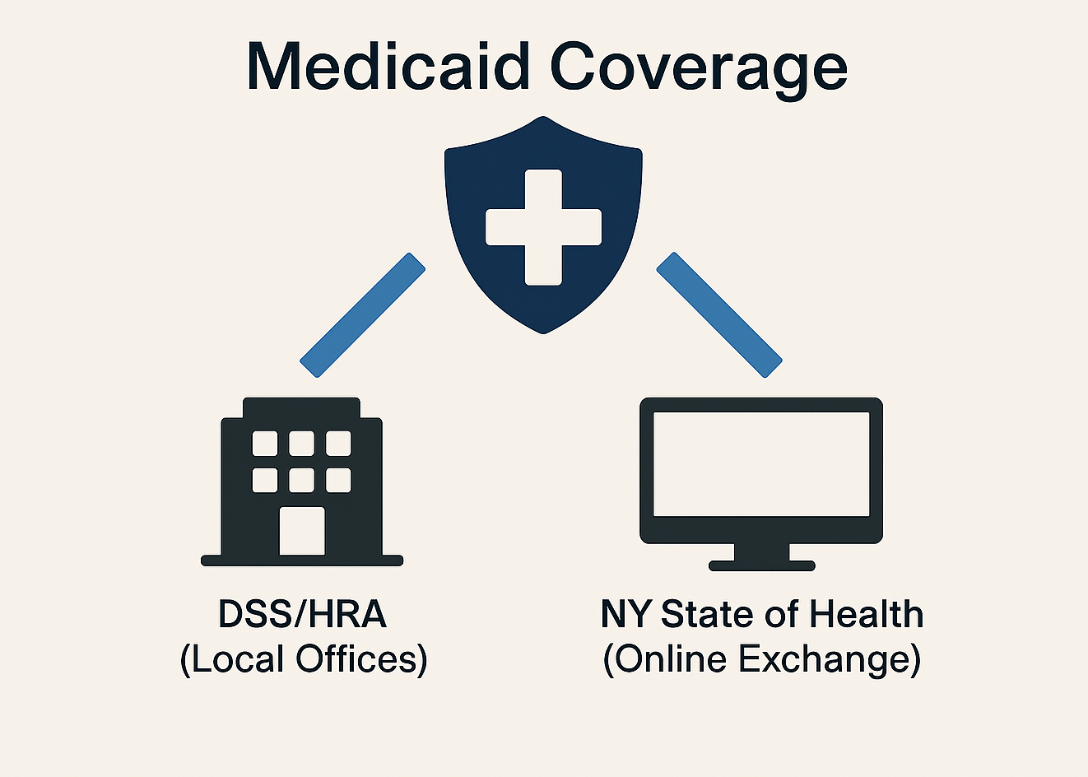
Same Coverage – Different Eligibility Rules

Slide 10
Differences Between DSS/HRA and NYSoH
Medicaid through DSS/HRA
  Most people getting OPWDD services have Medicaid from DSS/HRA (local departments of social services/county Medicaid offices)
  Can access Aged, Blind or Disabled benefits
    Requires disability determination by NYS Medicaid or Social Security Administration (SSA)
    Some income does not count toward Medicaid eligibility
    Special programs may help people keep Medicaid even with higher incomes
      Excess Income (spenddowns)
      Disabled Adult Child (DAC)
      Medicaid Buy-In for Working People with Disabilities (MBI-WPD)
      And more…
Medicaid through NYSoH (Affordable Care Act)
  Expanded Medicaid to cover more people – different eligibility rules based on IRS tax returns
    Modified Adjusted Gross Income (MAGI)
    Intended for non-disabled people and people not seeking HCBS Waiver services
  Medicaid Expansion Group – the group that Medicaid changes will affect most directly

Slide 11
Why do the differences matter?
No special budgeting available on NYSoH
  If someone has more income than the MAGI limit, they lose Medicaid coverage
    If income is over the MAGI limit, offers a subsidized health insurance plan
    If under 18 and parents’ income is over the MAGI limit, enrolls child in Child Health Plus
  IMPORTANT – subsidized health insurance plans/Child Health Plus DO NOT pay for OPWDD/HCBS Waiver services
NYSoH makes it harder for someone else, like a CM or advocate, to help the person obtain/maintain coverage
  NYSoH only speaks to the person, and person must have their account information available
  DSS/HRA will speak with others who are assisting a person with their Medicaid coverage/recognizes authorizations to release information to allow assistance
Changes that will affect the Medicaid Expansion Group (NYSoH) may not benefit the people we support
  Work requirements
  More frequent eligibility reviews
  Less retroactive eligibility
  Cost-sharing

Slide 12
What does this mean to me?
Everyone should have and maintain Medicaid coverage to protect the services and supports they receive/want to receive
  People with Medicaid through NYSoH (the Exchange) will be subject to the changes that will impact the Medicaid Eligibility Group
  If a person is determined “disabled” by Medicaid or the Social Security Administration (SSA), Medicaid should be through DSS/HRA
  Children (under 18) should not have Medicaid coverage through NYSoH
If you or someone you love has Medicaid through NYSoH and you have concerns about how this will affect you or them, please reach out to your Care Manager for assistance.
You do not have to navigate any of this alone – we are here to help!

Slide 13
Medicaid Work Requirement
Goes into effect January 1, 2027
Requires Medicaid applicant/recipient to:
  Work at least 80 hours/month
  Complete at least 80 hours of community service
  Participate in a work program for at least 80 hours
  Be enrolled at least half-time in an educational program
  Engage in any combination of these for at least 80 hours
ONLY applies to ABAWD (Able-Bodied Adults Without Dependents)
  Exemptions include people who are
    Blind
    Living with physical, intellectual, or developmental disabilities
    Diagnosed with mental illness or substance abuse disorder
    Living with serious or complex medical conditions
    Disabled veterans
    Parents or caregivers of people 13 and younger
    Parents or caregivers of people with disabilities
Proof that a person qualifies for an exemption likely to be required

Slide 14
Medicaid Eligibility Redeterminations
Medicaid eligibility review twice a year
  In effect October 1, 2027
  Only applies to people with Medicaid through NYSoH (Medicaid Expansion Group)
    Requires data matching and review by Medicaid program (does not mean a traditional “recert” process)
      Already occurs at application and once a year to renew coverage
      Will occur more frequently – at least twice per year
    In most cases, person themselves will not have to do anything
      Data matching occurs in the background
    Redeterminations on NYSoH are based on Modified Adjusted Gross Income (MAGI) reported on individual tax returns, so IRS records are used

Slide 15
Retroactive Medicaid Coverage
Retroactive coverage - currently
  Applying for Medicaid
    If person met eligibility rules and had unreimbursed expenses that Medicaid would have paid for if they had coverage for up to 3 months prior to the date of application, Medicaid coverage can be given for that period of time
  Lapses in Medicaid coverage (recertification not submitted before deadline)
    If person continued to meet eligibility rules for up to 3 months after coverage ends, Medicaid coverage can be given to cover that gap
Starting October 1, 2027
    Medicaid can only go back up to 2 months for disabled people (only 1 month if not disabled)
    Increases the importance of timely recertifications to avoid gaps in coverage and continuity of services

Slide 16
Medicaid Disability Determinations
A disability determination is required for applicants between the ages of 21-64 who are not certified disabled by SSA or the local Disability Service Program and seeking a disability determination and those chronically ill.
Group I includes individuals who show no possibility of engaging in any substantial gainful work activity because they have a physical and/or mental impairment(s) which is disabling and considered to be irreversible.
Group II includes individuals who have impairments which, while totally disabling at the time of determination, are expected to improve, enabling the individual to become capable of substantial gainful activity.
MAP-3177 -Disability Determination Request (This form must be submitted for all disability determination request)
DOH-5143-Medical Report for Determination of Disability (completed by an acceptable medical provider)
DOH-5139-Disability Questionnaire (This form is required for both adult’s and children's cases)

Slide 17
Medicaid Spenddown
Eligibility
  Certified blind or disabled
  Meet all Medicaid eligibility requirements other than income test
• Countable monthly income over the Medicaid income level is considered excess income
3/

Slide 18
Calculating a Spenddown
• Calculate countable monthly income
• Compare countable monthly income to applicable Medicaid income level based on living arrangement
• Excess income (Spenddown) is the amount of countable income that exceeds the Medicaid income level ($1,800)

Slide 19
Medicaid Buy-In for Working People with Disabilities (MBI-WPD)
MBI-WPD Eligibility
  Working
  NYS resident aged 16 to 64
  Certified disabled
  Under MBI-WPD income and resource limits
  Not living in an ICF/DC or receiving SSI

Slide 20
MBI Income & Resource Limits
MBI-WPD Income & Resources
MBI-WPD Income Limit
  Individual $3,261
  Couple $4,407
MBI-WPD Resource Limit
  Individual $32,532.00
  Couple $43,781.00
Calculating countable income:
  Total income (earned & unearned) – income exemptions = countable income

Slide 21
Special Medicaid Budgeting
Special Medicaid Budgeting for Former SSI Recipients
  DAC or Pickle budgeting
    DAC = Loss of SSI due to an initial or increased SSA benefit on a parent’s claim
    Pickle = Loss of SSI due to SSA COLA increases
Exempt all or part of SSA income
Remove or reduce a spenddown

Slide 22
Disabled Adult Child (DAC)
Individuals who lose SSI benefits due to either the initial receipt of Social Security benefits on a parent’s work record or a subsequent increase in the Social Security benefits may be able to retain their Medicaid coverage.
To be eligible for Medicaid as a DAC, all the following must be true for the person:
  Be at least 18 years old
  Have been eligible for SSI based on blindness or disability
  Have become blind or disabled prior to age 22
  Have lost SSI on or after July 1,1987 due to an initial entitlement to or an increase in SSA Disabled Adult Child benefits
  Continue to meet all other SSI eligibility requirements
  Live in an Individualized Residential Alternative (IRA), Community Residence (CR), Family Care (FC) home, or at home

Slide 23
PICKLE
Pickle Amendment
The Pickle Amendment allows an individual to continue to receive Medicaid if they lost SSI due to a Social Security Cost of Living Adjustment (COLA).
For continued Medicaid eligibility under the Pickle Amendment, the person must meet the following criteria:
At any time after April 1977, the individual was entitled to both Supplemental Security Income (SSI) and Social Security Retirement, Survivors, or Disability (Title II) benefits at the same time, and subsequently became ineligible for SSI because of Social Security cost of living adjustment; and
The individual is currently eligible for and receiving Title II benefits; and
The individual would be eligible for SSI if the COLAs received since the last month that they received both Title II and SSI benefits were disregarded; and
The individual must live in an Individualized Residential Alternative (IRA), Community Residence (CR), Family Care home (FC), or at home.

Slide 24
1619B
SSI recipients are often concerned that they will lose Medicaid if they go to work. Section 1619(b) of the Social Security Act provides some protection for these individuals by continuing Medicaid coverage if the individuals lost SSI payments because of earnings.
To qualify for this continuing Medicaid coverage, a person must meet all the following criteria:
  Have been eligible for an SSI cash payment for at least one month
  Still meet the disability requirement
  Still meet all other non-disability requirements for SSI
  Need Medicaid benefits to work
  Have gross earnings that are insufficient to replace SSI, Medicaid and publicly funded attendant care services

Slide 25
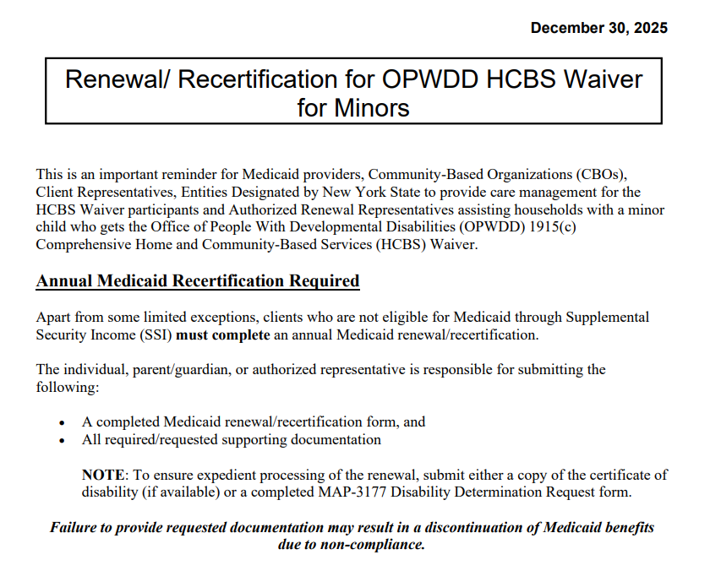
Medicaid & OPWDD HCBS Waiver for Minors

Slide 26
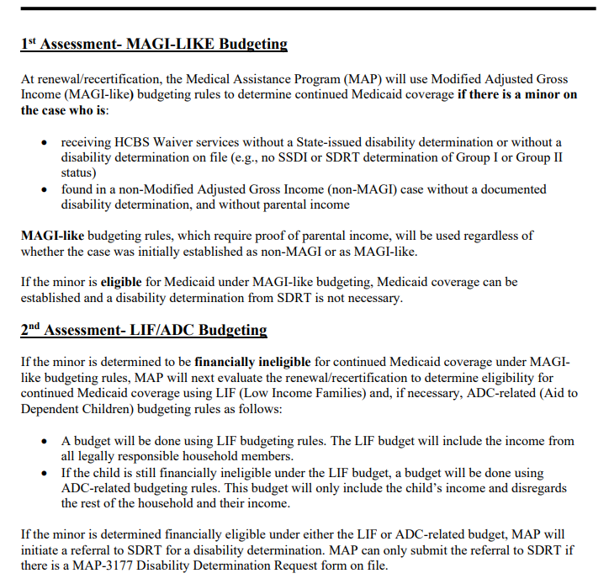
Medicaid & OPWDD HCBS Waiver for Minors

Slide 27
Definition Of Developmental Disability (OPWDD)
Section 1.03(22) of the New York State Mental Hygiene Law is the legal basis for OPWDD’s eligibility determination and defines Developmental Disability. “Developmental disability” means a disability of a person which:
  (a) (1) is attributable to intellectual disability, cerebral palsy, epilepsy, neurological impairment,
  familial dysautonomia, Prader-Willi syndrome or autism;
(2) is attributable to any other condition of a person found to be closely related to intellectual disability because such condition results in similar impairment of general intellectual functioning or adaptive behavior to that of intellectually disabled persons or requires treatment and services similar to those required for such person; or
    (3) is attributable to dyslexia resulting from a disability described in subparagraph one or two of this paragraph;
  (b)originates before such person attains age twenty-two; and
  (c) has continued or can be expected to continue indefinitely; and
  (d) constitutes a substantial handicap to such person's ability to function normally in society

Slide 28
SNAP Able-Bodied Adults Without Dependents (ABAWDs)
Starting March 1, 2026, Able-Bodied Adults Without Dependents (ABAWDs) aged 18–64 must document 80 hours/month of work, education, or volunteering to maintain SNAP benefits.

Slide 29
Able-Bodied Adults Without Dependents (ABAWD) Work Rules
An ABAWD is a person who is:
Aged 18 to 64,
Not living with a child under 14, and
Able to work.
You might not have to follow the ABAWD work rules, if:
You are younger than age 18, or age 65 or older,
Someone in your household is younger than age 14,
You receive disability benefits from a public or private source, such as Veterans Affairs or New York State disability benefits,
You are pregnant,
You are unable to work at least 80 hours per month because of a physical or mental health reason,
You are an Indian, Urban Indian, California Indian, or other Indian eligible for the Indian Health Services, or
You are excused from the General SNAP Work Rules*
*If you are between 60 and 64, you don't have to follow the general SNAP work rules. However, if none of the other conditions listed apply to you, you may still have to follow the ABAWD rules.

Slide 30
SNAP General Work Rules
You may not have to follow these rules if you are:
Younger than age 16, or age 60 years or older (Please read the important note below about people aged 60 to 64),
A 16 or 17-year-old who is not the head of the household or who is in school or in an employment program at least half-time,
Unable to work because of a mental or physical health reason,
Taking care of a child younger than age 6,
Taking care of an incapacitated person,
Meeting the work rules under the Temporary Assistance for Needy Families (TANF) program,
Receiving or applying for unemployment benefits,
Participating in a drug or alcohol addiction treatment program,
Enrolled in a school, training program, or college at least half-time (students may be subject to other eligibility rules),
Already working at least 30 hours per week,
Already earning $217.50 (30 times the federal minimum wage) or more per week, OR
An SSI applicant or recipient.

